Slide 1
Digital Portfolio
STUDENT NAME : Swathika M
REGISTER NO AND NMID: 2426J1570 & asbruaz2426j1570
DEPARTMENT : BSc.IT
COLLEGE : KPR College Of Arts Science And Research / Bharathiar University

Slide 2
PROJECT TITLE
UI/UX Portfolio

Slide 3


AGENDA
Problem Statement
Project Overview
End Users
Tools and Technologies
Portfolio design and Layout
Features and Functionality
Results and Screenshots
Conclusion
Github Link
3/21/2024 Annual Review

Slide 4

PROBLEM STATEMENT
Many portfolios fail to communicate both
creativity and usability.
Lack of structured presentation of skills,
process, and projects.
Employers need a clear, engaging, and
interactive portfolio to evaluate candidates
effectively.

Slide 5

PROJECT OVERVIEW
A digital UI/UX portfolio showcasing design thinking,
problem-solving, and project outcomes.
Demonstrates end-to-end design process:
research → wireframes → prototypes → final designs.
Highlights user-centric approach and usability testing.

Slide 6

WHO ARE THE END USERS?
Recruiters & Hiring Managers – evaluate candidate’s skills.
Clients – view project capabilities and case studies.
Peers & Mentors – provide feedback and collaboration.

Slide 7

TOOLS AND TECHNIQUES
Design Tools: Figma, Adobe XD, Sketch, Photoshop.
Prototyping & Wireframing: InVision, Balsamiq.
Collaboration: Miro, Notion.
Version Control: GitHub, GitLab.

Slide 8
POTFOLIO DESIGN AND LAYOUT
Clean, minimalist layout focusing on readability.
Sections: About Me, Skills, Case Studies, Projects, Contact.
Interactive navigation with consistent color palette & typography.
Responsive design for desktop, tablet, and mobile.
8

Slide 9
FEATURES AND FUNCTIONALITY
Interactive case study pages with detailed process flows.
Clickable prototypes & mockups embedded.
Downloadable resume option.
Contact form & social media integration.

Slide 10
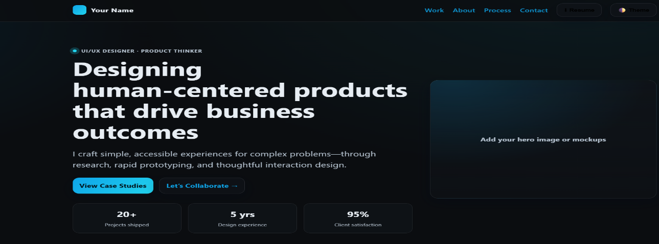
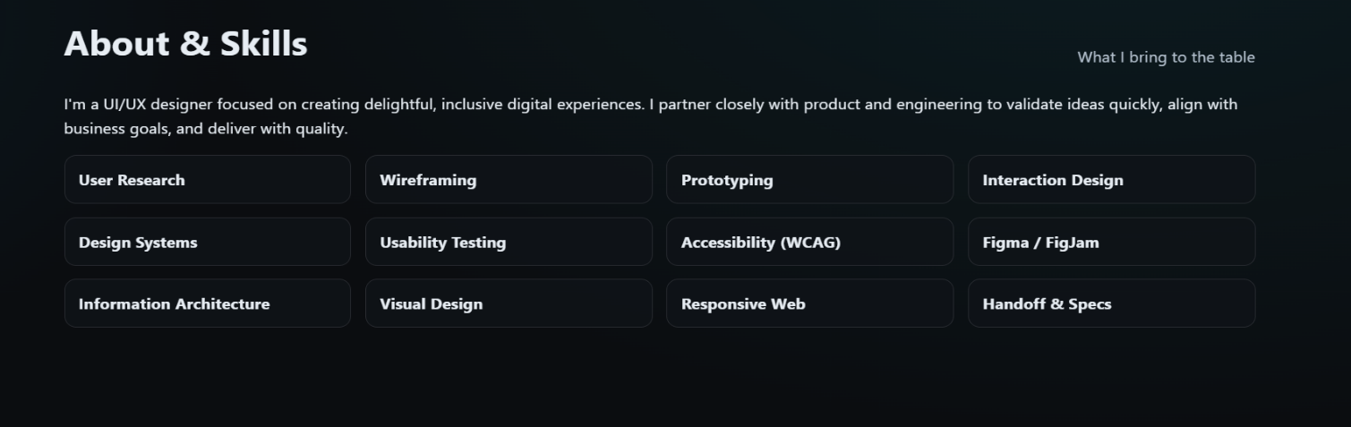
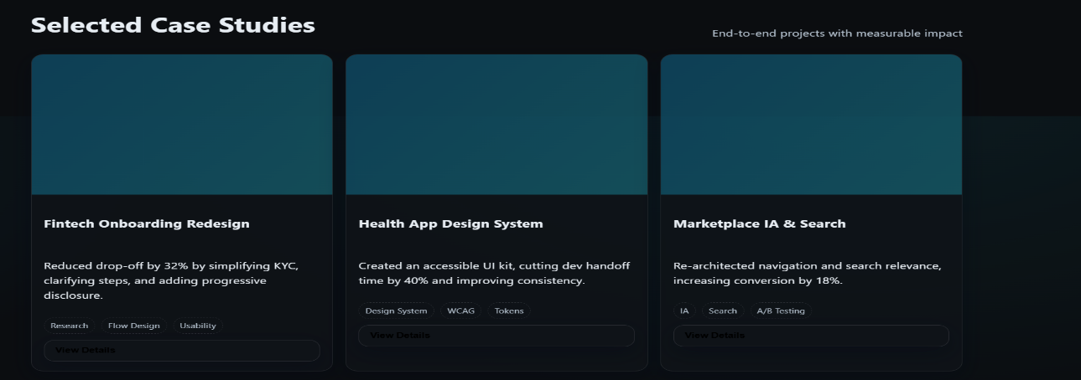
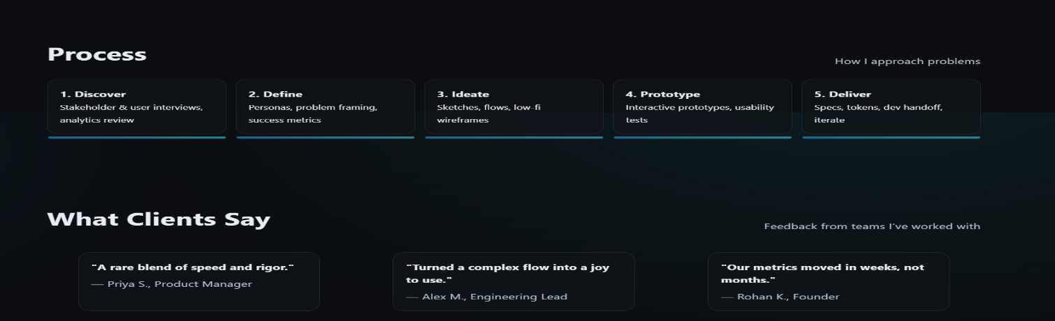
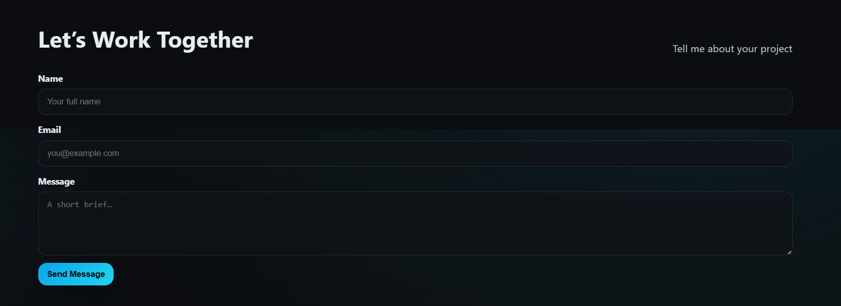
RESULTS AND SCREENSHOTS
10

Slide 11
CONCLUSION
A well-designed portfolio demonstrates both creativity and usability skills.
Acts as a professional brand identity for UI/UX designers.
Future scope: integrate animations, AI-based portfolio analytics, and interactive storytelling.
11

